Slide 1
Effective Strategies for Differentiating Mathematics Instruction for Early Learners
Prepared by:
Course
Date

Slide 2
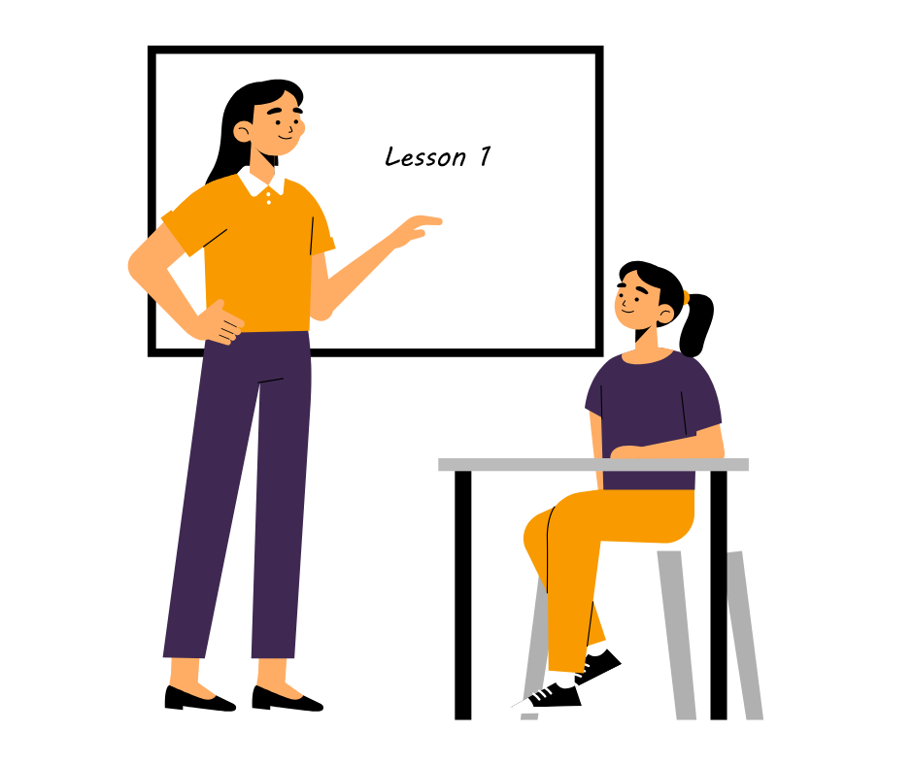
Introduction
Brief Overview:
  In early mathematics teaching, differentiation is crucial in ensuring that all students have equitable access to learning opportunities regardless of their background or ability level (Šmitienė et al., 2024).
  By differentiating instruction, teachers can meet the diverse needs of their students, allowing each child to progress at their own pace and reach their full potential.
Research Question:
  "What are effective strategies for differentiating mathematics instruction to meet the diverse needs of early learners?"
  This question guides our exploration into practical methods and approaches that empower teachers to effectively support the learning needs of every student in the mathematics classroom.

Slide 3
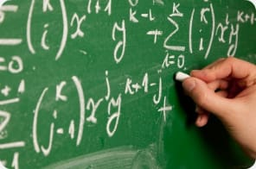
Understanding Differentiation
Differentiation in mathematics teaching is the adjustment of teaching procedures, materials, and assessments to present variations in interests and readiness among the learners. This means it involves giving many possibilities of access and participation in mathematical ideas so that every student finds the potential for progress and success (Salahudin et al., 2024).
Importance of Recognizing and Addressing Diverse Needs
Each student entering a mathematics classroom brings prior experiences, strengths, and unique weaknesses.
In recognition, therefore, there has to be handling of such diverse needs, which is very important in promoting equity and ensuring that every student has a chance to perform excellently in mathematics.
Using differentiation, teachers can create a learning atmosphere that accommodates all and ensures that each learner feels recognized and supported in their mathematical voyage.

Slide 4
Assessing Student Needs
Strategies for Assessing Students' Mathematical Abilities and Learning Styles:
  Pre-assessment: Administer diagnostic assessments at the beginning of the school year or unit to gauge students' prior knowledge and skills in mathematics.
  Observations: Actively observing students during mathematics activities and tasks to identify their strengths, areas for improvement, and preferred learning styles.
  Informal Conversations: Engaging in one-on-one or small group discussions with students to gather insights into their mathematical thinking processes, interests, and challenges.
  Learning Inventories: Surveys or questionnaires collect students' attitudes toward mathematics, preferred learning strategies, and areas of interest.
Importance of Ongoing Formative Assessment:
  Formative assessment involves gathering real-time feedback on students' learning progress and understanding throughout the instructional process.
  Teachers can make timely adjustments to their instructional strategies, pacing, and materials by continuously assessing students' needs and understanding.
  Ongoing formative assessment promotes responsive teaching practices, enabling teachers to address misconceptions, provide additional support, and challenge students to be ready for more advanced content (Sappaile et al., 2024).

Slide 5
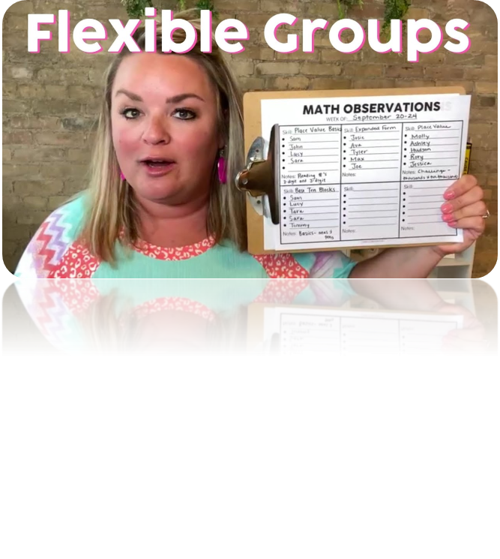
Flexible Grouping
Explanation of Flexible Grouping Strategies:
  Ability Grouping: Students are grouped based on their current mathematical proficiency or skill mastery level. This allows teachers to provide targeted instruction tailored to the specific needs of each group.
  Interest-Based Grouping: Students are grouped according to their interests or preferences in mathematics topics or activities. This fosters engagement and motivation by allowing students to explore concepts that resonate with their interests.
  Mixed-Ability Grouping: Students of varying levels of mathematical ability are grouped within the same learning environment. This promotes peer learning, collaboration, and the development of social-emotional skills (Apolinario, 2024).

Slide 6
Cont’d Flexible Grouping
Benefits of Each Grouping Strategy:
  Ability Grouping:
    Allows teachers to differentiate instruction according to students' readiness levels, ensuring each group receives appropriate challenges and support.
    Provides opportunities for students to work at a pace that matches their individual learning needs, minimizing feelings of frustration or boredom.
  Interest-Based Grouping:
    Increases student engagement and motivation by allowing them to explore mathematics topics that align with their interests and passions.
    Encourages student ownership of learning as they take an active role in selecting and pursuing topics of interest.
  Mixed-Ability Grouping:
    It fosters a sense of belonging and community as students collaborate with peers of diverse backgrounds and abilities.
    Promotes peer learning and cooperation, with more advanced students supporting their peers and reinforcing their understanding through teaching and explanation.

Slide 7
Differentiated Instructional Materials
Overview of Using Varied Instructional Materials:
  Differentiated instructional materials refer to a range of resources, tools, and aids teachers use to support student learning in mathematics. These materials encompass manipulatives, visuals, technology, and other resources that cater to students' diverse needs and learning styles.
  By incorporating varied instructional materials into mathematics instruction, teachers can provide multiple entry points for understanding, promote active engagement, and reinforce critical concepts through different modalities (Uzun, 2024).
Examples of How Different Materials Can Support Different Learners:
  Manipulatives: Concrete objects such as counters, base-ten blocks, and geometric solids can help tactile learners explore mathematical concepts through hands-on manipulation and visual representation.
  Visuals: Graphic organizers, diagrams, charts, and diagrams can aid visual learners in understanding abstract mathematical concepts by providing visual representations and organizing information in a clear, visual format.
  Technology: Educational apps, interactive whiteboards, online simulations, and virtual manipulatives offer interactive and dynamic learning experiences that appeal to digital natives and provide opportunities for exploration, practice, and feedback.
These diverse instructional materials empower teachers to differentiate instruction effectively and cater to every student's unique learning preferences and needs in the mathematics classroom (Rofiki & Alghar, 2024).

Slide 8
Individualized Learning Plans (ILPs)
Introduction to Individualized Learning Plans (ILPs):
  Individualized Learning Plans (ILPs) are personalized educational plans designed to address the unique learning needs, strengths, and goals of students with specific learning needs, such as students with disabilities, English language learners, or gifted learners (Allsopp & Eskelson, 2024).
  ILPs provide a framework for identifying and documenting individualized accommodations, modifications, and instructional strategies to support student learning and success in the classroom.
Collaboration Between Teachers, Students, and Parents in Developing and Implementing ILPs:
  Teachers: Work collaboratively with students and parents to gather input, assess students' strengths and needs, and develop individualized goals and strategies that align with students' learning profiles.
  Students: Actively participate in the development of their ILPs by reflecting on their learning preferences, setting goals, and providing feedback on instructional approaches that are effective for them.
  Parents: Contribute valuable insights and perspectives on their child's learning needs, preferences, and progress, and collaborate with teachers to support implementing ILP goals and strategies at home.
Effective collaboration among teachers, students, and parents ensures that ILPs are meaningful, responsive, and tailored to students' individual needs, fostering a supportive learning environment where every student can thrive.

Slide 9
Reflection
Reflection on the Journey of Exploring Effective Strategies for Differentiating Mathematics Instruction:
  Throughout this exploration, I have gained a deeper understanding of the importance of differentiation in mathematics instruction and its impact on student learning outcomes.
  I have discovered various practical strategies, such as flexible grouping, tiered assignments, differentiated instructional materials, and ILPs, that empower teachers to meet the diverse needs of early learners in the mathematics classroom.
Personal Insights Gained:
  Recognizing each student's unique strengths, interests, and learning styles is essential for effective differentiation.
  Differentiation requires ongoing assessment, reflection, and adaptation to ensure that instruction is responsive to students' evolving needs and abilities.
  Collaboration with students, parents, and colleagues is critical to developing and implementing effective differentiation strategies that support student success.
Implications for Future Practice:
  I am committed to integrating differentiated instruction into my mathematics teaching practice to create inclusive learning environments where all students can thrive.
  I will continue to refine my assessment practices and utilize various instructional strategies and materials to meet the diverse needs of my students.
  I recognize the importance of ongoing professional development and collaboration with colleagues to deepen my understanding of differentiation and enhance my effectiveness as a mathematics educator.
This journey of exploration has inspired me to embrace differentiation as a cornerstone of my teaching philosophy and to continuously strive to meet the needs of every student in the mathematics classroom.

Slide 10

Conclusion
Summary of Key Takeaways Regarding Effective Strategies for Differentiating Mathematics Instruction:
  Effective differentiation in mathematics instruction involves tailoring teaching methods, materials, and assessments to accommodate early learners' diverse needs, interests, and readiness levels.
  Strategies such as flexible grouping, tiered assignments, differentiated instructional materials, and ILPs empower teachers to provide personalized learning experiences that promote student engagement, motivation, and success.
  Ongoing assessment, collaboration, and reflection are essential components of differentiated instruction, enabling teachers to adapt and refine their practices to meet the evolving needs of their students.
Reiteration of the Importance of Meeting the Diverse Needs of Early Learners:
  Every student deserves equitable access to high-quality mathematics instruction that supports their individual learning needs and fosters mathematical growth and development.
  By embracing differentiation and implementing effective strategies in the mathematics classroom, teachers can create inclusive learning environments where all students can thrive and reach their full potential.
In conclusion, prioritizing differentiation in mathematics instruction is essential for promoting equity, engagement, and achievement among early learners, and educators must meet the diverse needs of every student in the mathematics classroom.

Slide 11
References
Allsopp, D., Eskelson, S. L., van Ingen Lauer, S., Hinton, J., Farmer, J., & Hughes, E. K. (2024). TEACHING Exceptional Children. doi:10.1177/00400599241242326
Apolinario Apolinario, N. M. (2024). Moodle Interactive Model to Strengthen Mathematical Competencies in Eighth-Year Basic Education Students. https://repositorio.ucv.edu.pe/handle/20.500.12692/139265
Lo, C. K., Ng, D. T. K., & Ng, F. (2024). Observing Mathematical Properties in the Virtual World: An Exploratory Study of Online Independent Learning of Locus Concepts. International Journal of Science and Mathematics Education, 1-22. https://link.springer.com/article/10.1007/s10763-024-10466-2
Rofiki, I., & Alghar, M. Z. (2024). The Failure of National Madrasah Science Competition Students in Solving Islam-Integrated Mathematics Problem on Triangle Material. Jurnal Riset Pendidikan dan Inovasi Pembelajaran Matematika (JRPIPM), 7(2), 151-170. https://journal.unesa.ac.id/index.php/jrpipm/article/view/28154
Salahudin, A., Mufida, S. I., & Pratiwi, I. M. (2024). Means End Analysis (MEA): A Learning Model to Improve Mathematics Cognitive Learning Outcomes in the Post-Pandemic COVID-19. KnE Social Sciences, 325-336. https://knepublishing.com/index.php/KnE-Social/article/view/15933
Sappaile, B. I., Mayadiana, D., Lengam, R., Guilin, X., & Abda, M. I. (2024). Influence of the Blended Learning Method on Student Achievement in Mathematics Lessons. Journal Emerging Technologies in Education, 2(2), 122-132. https://journal.ypidathu.or.id/index.php/jete/article/view/810
Šmitienė, G., Melnikova, J., Batuchina, A., & Šakytė-Statnickė, G. (2024). Need, advantages and capabilities of learning analytics in K12 education: study results from Lithuania. Journal of digital pedagogy., 3(1), 11-17. https://vb.kvk.lt/object/elaba:194273225/
Uzun, A. G. (2024). The development of mathematical argumentation: A case study on two mathematics classrooms. International Electronic Journal of Mathematics Education, 19(2), em0778. https://www.iejme.com/download/the-development-of-mathematical-argumentation-a-case-study-on-two-mathematics-classrooms-14581.pdf

