Slide 1
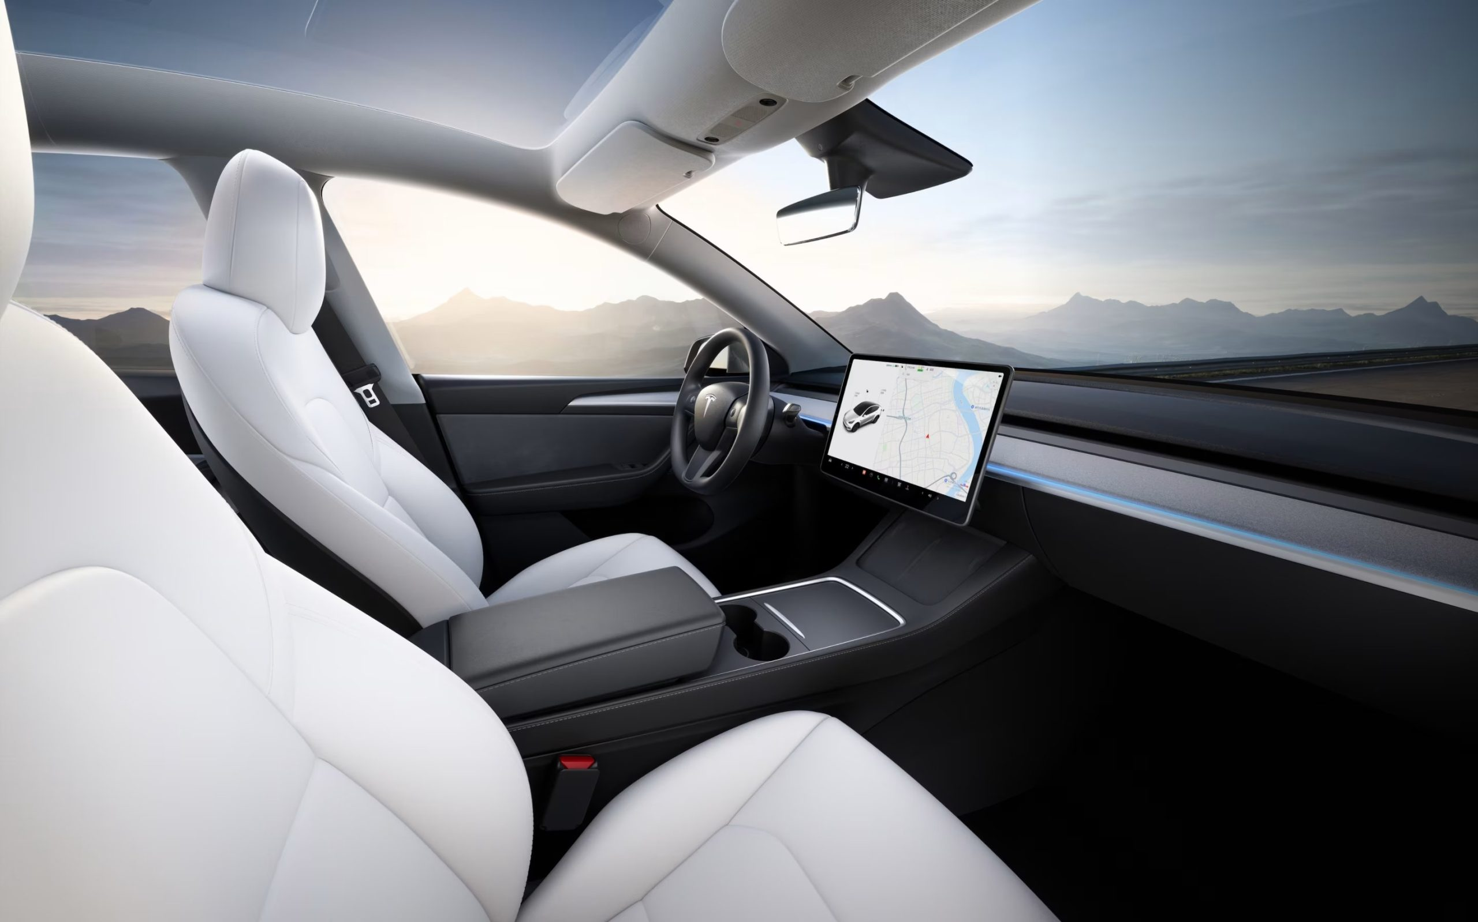

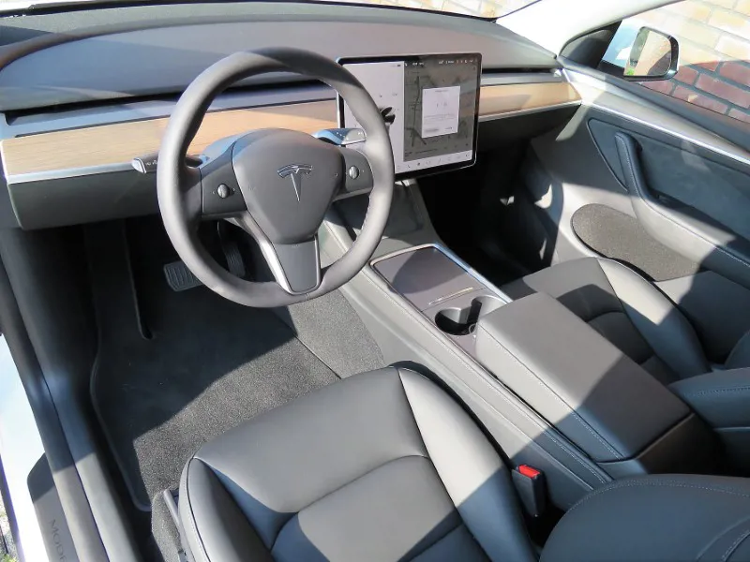
Model Y Tesla
Prepared by:
Course
Date

Slide 2

Presentation Agenda
The agenda in this presentation includes;
Exploring human needs that Tesla fulfills.
Describing Tesla’s personality (Model Y)
Explore the reason for people choosing Tesla over other competitors.
Present recommendations to improve Tesla’s brand to enhance consumers’ experience.

Slide 3
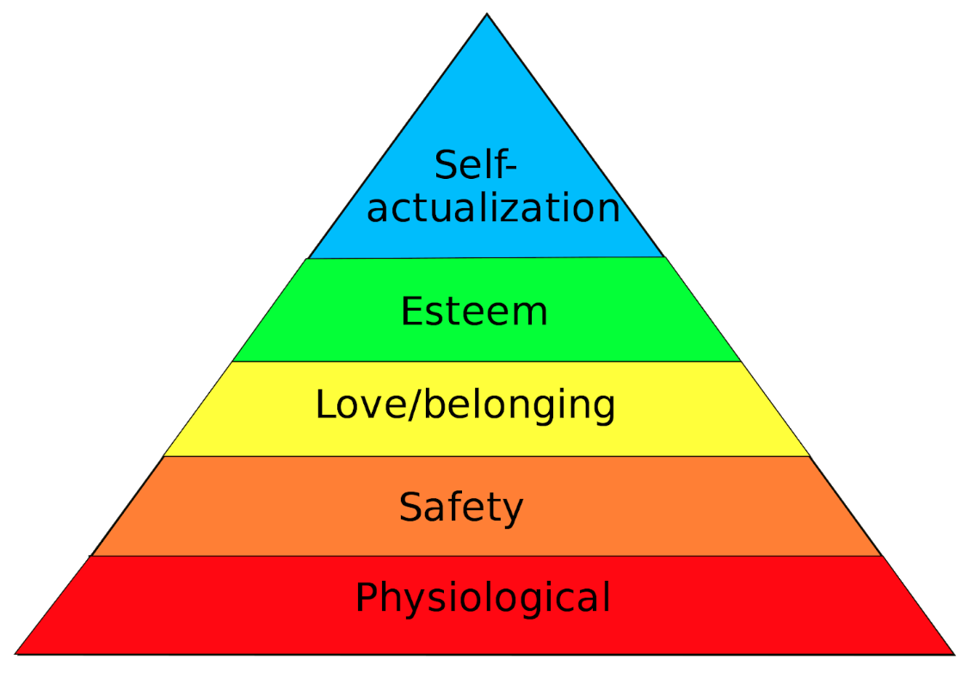
Introduction - How Tesla Model Y is Fulfilling Human Needs
Exploring how Tesla’s Model Y fulfills human needs can be understood using Maslow’s Hierarch of Needs.
Maslow’s model highlights different levels of needs, including
Physiological.
Safety and security.
Love and belongingness.
Esteem.
Self-actualization (Poston, 2009).
Exploring how Tesla addresses these needs helps understand why the model is more than transportation but also resonates with the various needs of the consumers.
Maslow’s Hierarch of Needs Pyramid

Slide 4
Cont’d - Fulfilling Human Needs
i. Physiological Needs
This needs revolves around basic human needs such as clothing, sleep, food, and shelter, resonating around satisfaction for survival.
Tesla’s Model Y addresses these needs by offering a reliable and sustainable mode of transportation for users in their daily activities.
As an energy-efficient car, this translates to a cost-saving for the users, making transportation easily accessible for them.
ii. Safety and Security
This need revolves around the need for emotional and physical safety, health, stability, and protection.
Tesla’s Model Y fulfils this need with its emphasis on various safety measures. These include.
Robust design, with added advanced materials such as in the event of a collision.
Advanced driver-assistance systems such as autopilot.
Such systems contribute to adaptive cruise control, lane keeping, and accident prevention.
User guide systems, which help the drivers with real-time alert and safety information, fostering confidence and a sense of control on the roads

Slide 5
Cont’d - Fulfilling Human Needs
iii. Love and belongingness
According to Maslow, this need revolves around the social need for acceptance, belonging, affection, love, and overall connection with communities, friends, or family.
Tesla fulfills this need by developing platforms and events where Model Y users share insights, form connections, and offer advice.
For instance, Tesla records different events, seminars, and others on the websites for users to attend.
This creates a sense of belonging among the users.
iv. Esteem
This need revolves around recognition, achievement, confidence, and respect from others.
Tesla’s Model Y fulfils this need with its added technologies and other aspects, which differentiate it from other cars.
This contributes to users, elevated self-esteem and accomplishment.
v. Self-actualization
This need involves focusing on one’s personal growth, creativity, ones’ potential, and self-fulfillment.
Owning Tesla’s Model Y signifies a commitment to aligning with environmental innovation aimed at achieving a sustainable future.

Slide 6
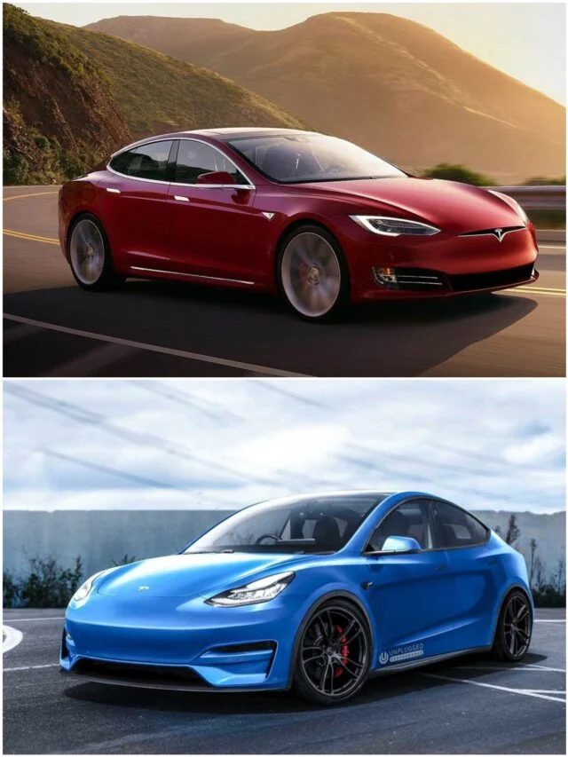
Description of Tesla’s Personality
Tesla’s personality presents significant traits, which shape the users’ perception.
These exhibited personalities include a commitment to sustainability and sophistication.
Commitment to sustainability and innovation
Tesla’s brand has technologies such as auto-pilot systems and AI integration.
The brand’s commitment to sustainability extends beyond just car operation, which includes end-of-life considerations such as re-usable batteries.
The brand leads in the electronic automotive industry through aligned modern customer values, including sustainability and socially responsible products.
Sophistication
Tesla’s Model Y exudes sophistication in all aspects, including modernity and sleek design.
The company pays attention to detail, where every element is characterized by functionality, catering to the users’ refined and discerning tastes.

Slide 7
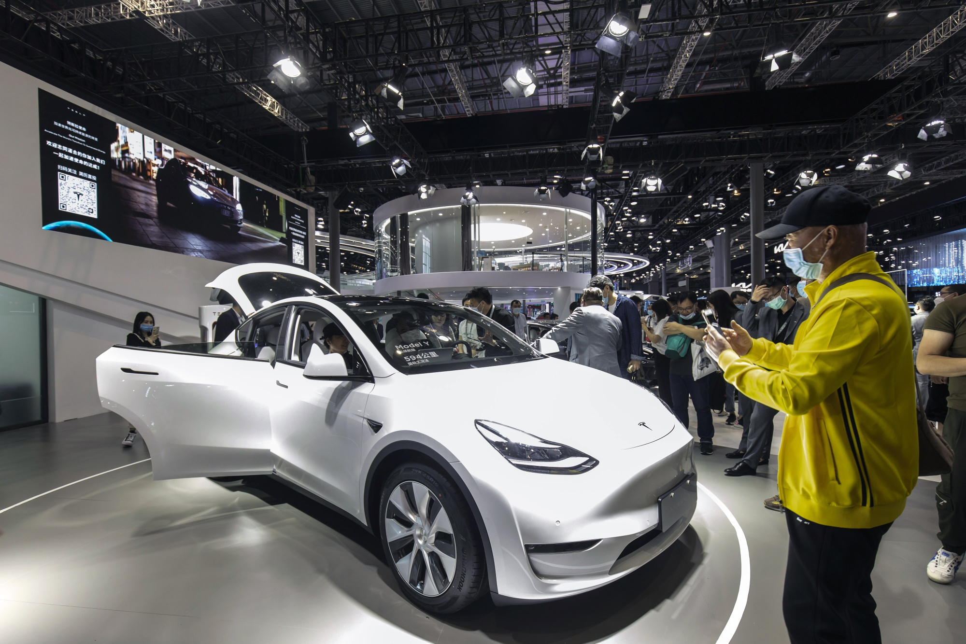
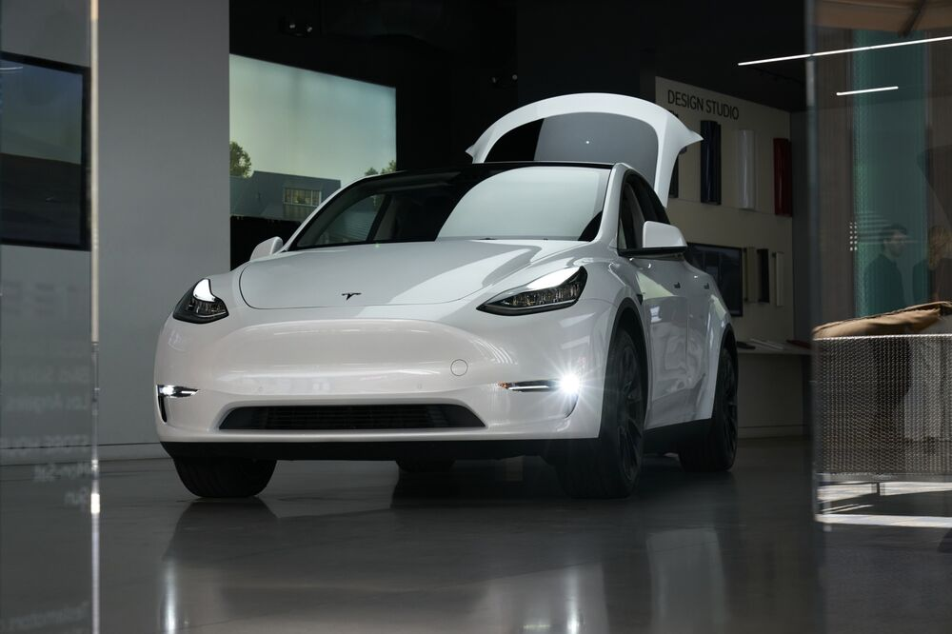
Why Consumers Choose Model Y Over Other Competitors
In the electronic automotive industry, there are different competitors, including General Motors, Toyota, BMW, BYD, Rivian, etc, but customers consider Model Y for different reasons.
The recorded reasons were collected from interviews with four Model Y users.
Reason 1: Superior technology
Tesla boasts superior technology, which increases users’ safety on the road.
These superior technologies include self-driving capabilities and real-time monitoring.
In addition, these technologies are ahead of the competitors.
Reason 2: Sustainable practices
As an environment-conscious brand, customers choose it as it contributes to a greener future.
Most of the other competitors in the automotive industry lack the same dedication to driving solutions and sustainable production.

Slide 8
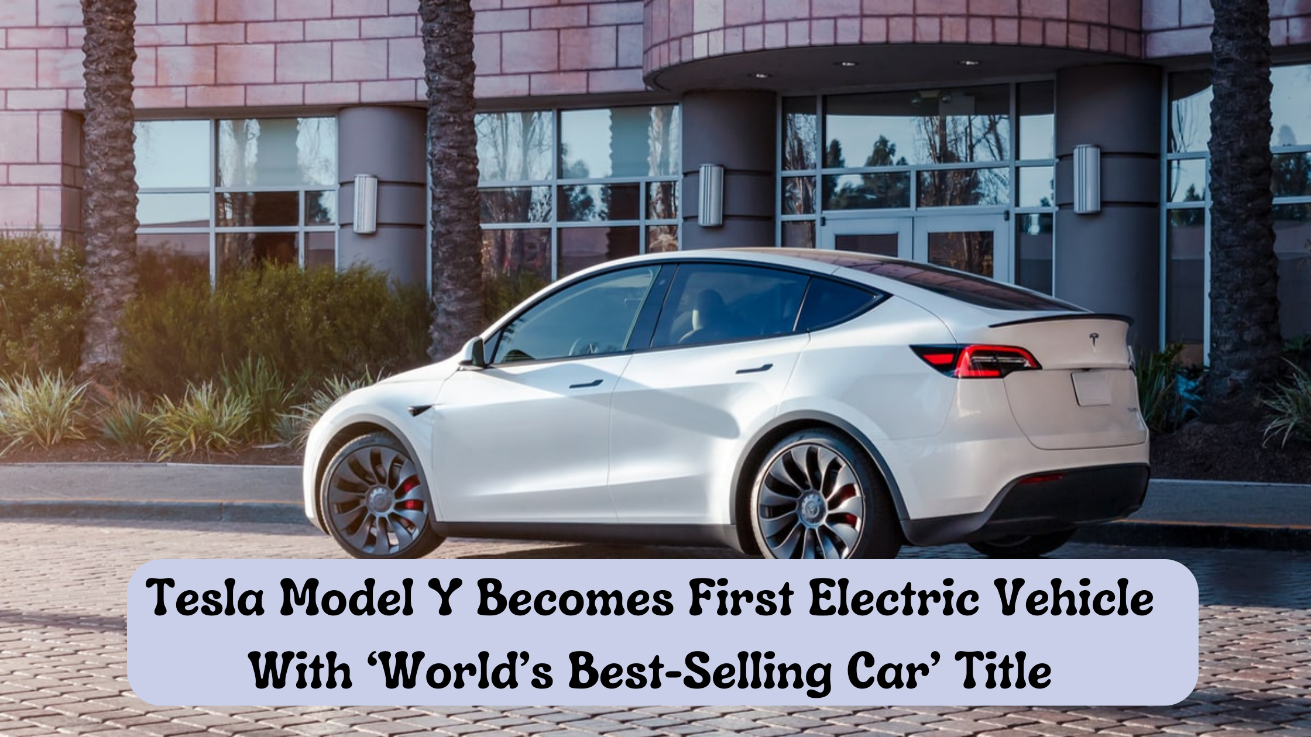
Cont’d – Preference for Tesla Model Y
Reason 3: Thriving Community
Tesla introduces a supportive and engagement community, such as through events, seminars,
Through these communities, users share experiences, tips, and other relevant information which goes beyond the driving experience.
Another important aspect of the thriving community is guidance and support, where existing and new owners collaborate in an environment to share solutions, provide guidance, and address various queries.
Reason 4: Continuous Advancements
Tesla’s dedication to the continuous advancement of its model distinguishes it from competitors.
The brand always provides regular updates, ensuring performance enhancement and better capabilities.
These updates are often done online, where users do not have to visit the service centers, setting Tesla Model Y apart from other competitors.

Slide 9
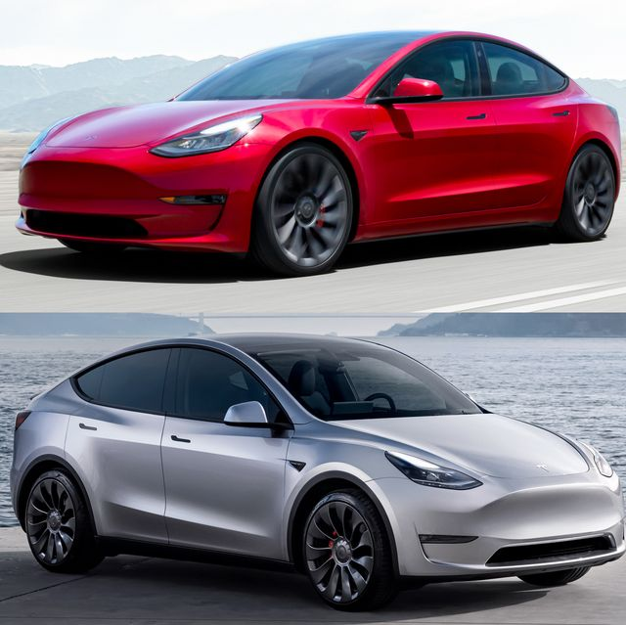
Cont’d - Preference for Tesla Model Y
Reason 5: Enhanced User Experience
Tesla’s commitment to provide better user experience is a key element to differentiate it from competitors.
Model Y’s user-centric design not only has aesthetic appeal but also has a comfortable experience.
The integrated features are introduced to enhance both the convenience and safety of the users.
“The combination of innovative autonomy features, continuous updates, community engagement, sustainability, and superior technology, Model Y offers the users a multifaceted ownership experience, making them consider the brand over others.”

Slide 10
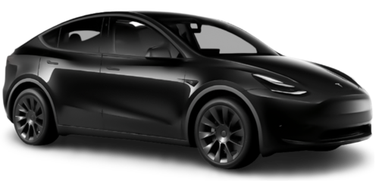
How Tesla Will Improve Its Brand
In addition to the innovative technologies, Tesla needs to adopt a strategic approach to reach more customers.
Current Scenario
Model Y currently stands out as a unique innovation in the electric car industry, but its price is a barrier to many potential customers.
The current price for Model Y is $43,990.
For the long-range version, the model costs up to $50,000.
As the vision envisions making the model accessible to more customers, the set price will play an important role.
Price plays a significant role in consumers’ increased accessibility (Reddick et al., 2020). .
Suggestion Adjustment
The suggested adjustment is decreasing the price by 3%, so the new cost of the model will be $42,000.
This, overall, will invite a more extensive demographic to the targeted market.

Slide 11
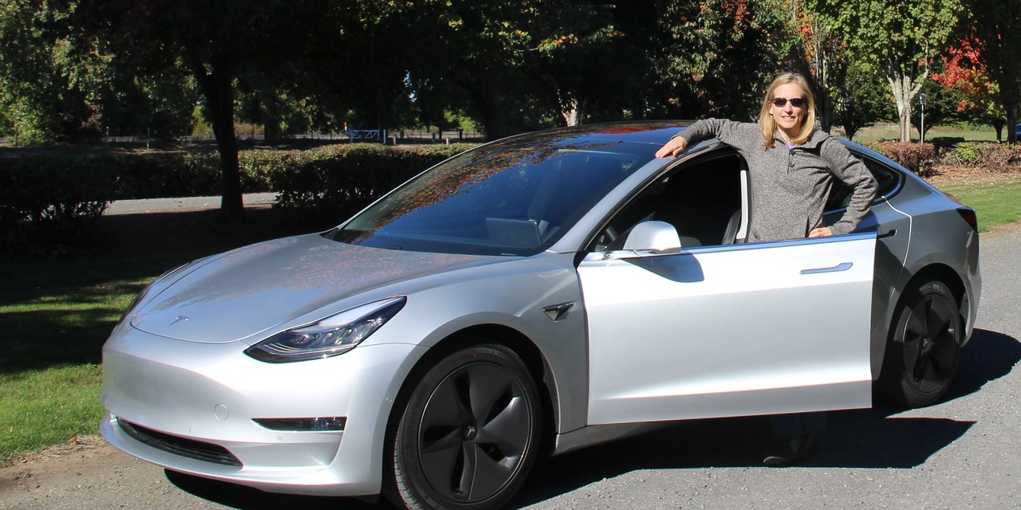
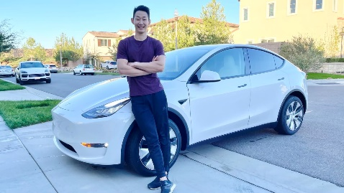
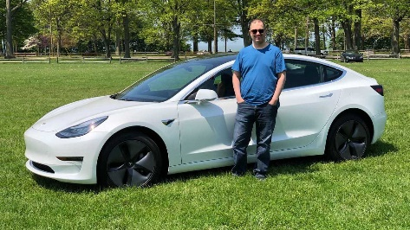
Cont’d- How Price Adjustment Will Impact the Brand
Decreasing the price by 3% is projected to broaden the market accessibility for the Model Y in various ways;
i. Improved brand perception
Price adjustment will reinforce the company’s image as a brand pioneering inclusivity and innovation to everyone in society.
This will foster a positive consumer perception, viewed as a socially and environmentally responsible company.
ii. Long-Term brand loyalty
Making the brand mode accessible will lay a strong foundation for the company for long-term advocacy and loyalty.
This win return will have a positive impact on the company’s growth through a lasting relationship with a broad customer base.
iii. Market Expansion
Adjusting the price will strategically position the brand in a place where it will be able to attract different demographics.
In a study conducted by Hardman et al. (2017), most of the participants want to own a Tesla just that they cannot afford it.

Slide 12
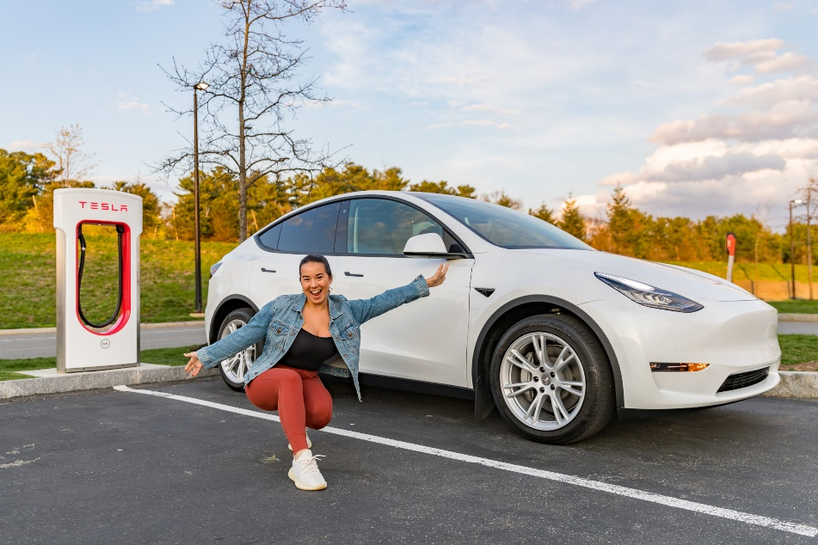
Cont’d – Improving Tesla Brand Recommendation Two
The second recommendation is to improve customers’ experience.
Exploring the current customers’ experience based on conducted interviews, there is room for further refining the services journey.
The primary objective of this strategy is ensuring customer satisfaction, strengthening brand loyalty.
A strategic approach to achieving better customer experience is investing more on service efficiency.
This will particularly involve reduced downtimes and minimal response time.
Key focus areas to improve customer experience include;
Adopting effective and transparent communication channels.
Expediting and refining the maintenance procedures, reducing time users spent in the service centers.

Slide 13
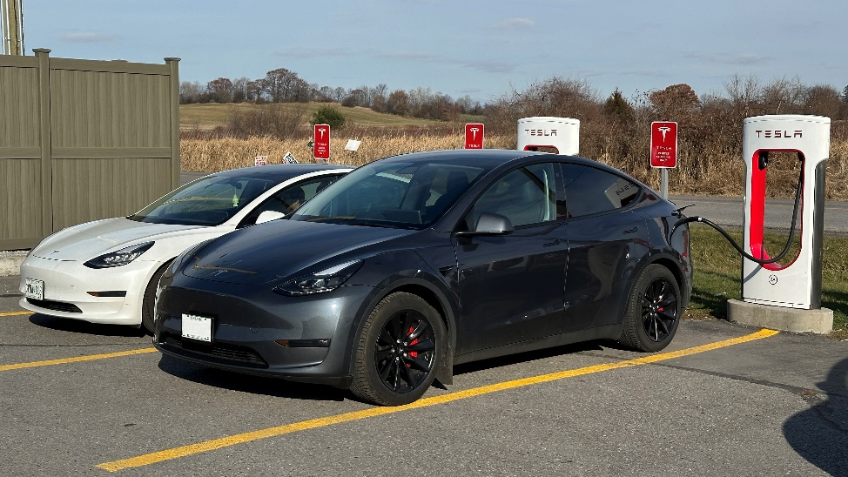
Cont’d – Improving Customer Experience
Other key areas that Tesla will need to invest in to enhance customer experience include;
i. Assessing customers’ feedback
Tesla will need to introduce a feedback mechanism where they can assess consumers’ satisfaction.
This will allow the service processes to evolve by aligning them with the Model Y owners’ expectations and needs.
ii. Increase charging ports
Tesla will need to invest heavily in charging stations for the Tesla cars.
One of the interviewee highlighted worrying about where to charge her Model Y.

Slide 14

Conclusion
The presentation has helped explore how the Tesla Model Y has addressed the key human needs as a leader in the electric car market.
Additionally, to meet human needs, the brand has a distinct personality characterized by a commitment to innovation and sophistication, which sets the brand apart.
A key reason why most customers choose Tesla over other competitors is its capability to stay ahead of the competitors.
This includes the innovative autonomy features, continuous development, engagement, and sustainability, ensuring Model Y offers better advantages than competitors.
Looking into the future, Tesla will need to reduce its price, helping attract more customers and improve the brand’s image.
This will also need investing more in customer services, such as adding more charging stations for better experiences.

Slide 15
References
Hardman, S., Shiu, E., Steinberger-Wilckens, R., & Turrentine, T. (2017). Barriers to the adoption of fuel cell vehicles: A qualitative investigation into early adopters attitudes. Transportation Research Part A: Policy and Practice, 95, 166-182.
Poston, B. (2009). Maslow’s hierarchy of needs. The surgical technologist, 41(8), 347-353.
Reddick, C. G., Enriquez, R., Harris, R. J., & Sharma, B. (2020). Determinants of broadband access and affordability: An analysis of a community survey on the digital divide. Cities, 106, 102904.

Slide 16
Thank You

