Slide 1
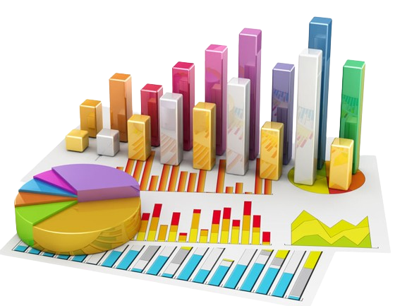
Research Project
Name:
Course:
Due Date:

Slide 2
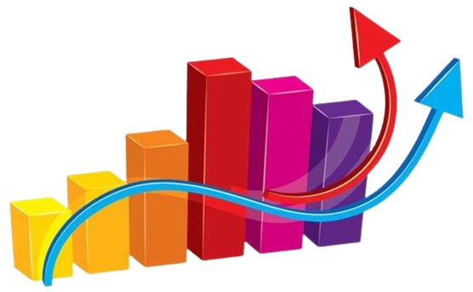
1. Introduction – Research Overview
Research Title
Impact of Digital Marketing on Brand Awareness and Purchase Intent: A Case Study of Amazon
Research Question
How does the strategic implementation of digital marketing initiatives influence brand awareness and purchase intent among consumers in diverse industry sectors?
Project Aim
This research project aims to examine and explore how the strategic implementation of digital marketing methods in various industry sectors affects buyer awareness of a brand and buying intentions. The aim is to establish the main elements and channels through which digital marketing tools affect customer views, leading to increased brand recognition and enhanced purchase intention..
Objectives
Review and classify different approaches deployed by firms in various industries concerning their digital marketing efforts
Measure and evaluate how various digital marketing campaigns affect a brand's awareness across specific industries, examining aspects like increased online exposure, brand recall, and customer recognition to determine the role of digital marketing in enhanced brand awareness.
Explore the impact of digital marketing initiatives on consumer behavior and intention to purchase in different business settings.
Notes:
In this paper synthesis, the main topic is alluded at by the title – study of the influence of brand awareness and purchase intent under the influence of digital marketing referred to Amazon as a case. This is where the brevity and lucidness of this statement make it possible for the researchers to pinpoint the core issue underlying the research inquiry as to exactly how the strategic digital marketing programs affect consumer behaviour in various industries. Given the wider purpose of the project, the aim of the project describes the general purpose with precisely focused on the strategic communication of the digital marketing and its implication in the buyer consciousness and action. The goals further narrow down the steps that could be taken to realize this goal which involve a review and categorization of aspects of digital marketing, a measurement of the campaign effects and identifying the relationship between digital strategies and consumer practices. This aligns with the preset objectives that, if taken together, constitute a powerful framework for inclusive research. The footnotes underscore the methodical essence, ensuring a connotative cognition of the syndetic link between digital marketing, brand recognition, and purchase intent and Amazon’s case serves as a captivating setting of a practical analysis.

Slide 3
Part Two: One-Variable Analysis

Slide 4
One-Variable Analysis
a. Variable One – Educational Attainment Data Set
The line graph shows years of schooling, across different levels of education.
The years of schooling range up to 8 years.
Different levels based on years includes;
Year 1 to 2 College.
Year 3 to 5 Bachelor’s
Year 5 to 6 Master’s
Year 6 to 8 Doctorate or PH.D
Figure 1: Line graph on years of Schooling

Slide 5
Mean, Median, and Mode on Educational Attainment Data Set
Descriptive Statistics
 | N | Minimum | Maximum | Mean | Std. Deviation | Mode | Median
Years of Schooling | 29 | 1 | 8 | 4.24 | 2.278 | 1 | 4
The dataset consists of 29 observations on years of schooling, ranging from a minimum of 1 year to a maximum of 8 years.
The mean years of schooling is 4.24 with a standard deviation of 2.278, indicating a moderate level of variability around the average.
The analysis is based on a valid list of 29 observations.

Slide 6
Cont’d - One-Variable Analysis
B. Variable Two – Income Level Data Set
The line graph shows average income levels.
This is from different industries including;
Academic positions, e.g lecturers.
Senior levels such as management.
Engineering.
Healthcare.
Trades and technical professions such as electricians.
Entry level positions.
Customer service.
Finance and Banking.
Marketing.
Figure 2: Income level

Slide 7
Mean, Median, and Mode on Income Level Data Set
Descriptive Statistics
 | N | Minimum | Maximum | Mean | Std. Deviation | Median | Mode
Average Income | 29 | 30000 | 67000 | 47551.72 | 11245.91 | 47000 | 30000
The dataset comprises 29 observations on average income, ranging from a minimum of $30,000 to a maximum of $67,000.
The mean average income is $47,551.72, with a standard deviation of $11,245.91, indicating a notable degree of variability around the mean.
The descriptive statistics was calculated based on a valid list of 29 observations.

Slide 8
Trends or something interest and What I learned from the Data sets
On the number of schooling years, the data set entailed participants with different levels of education. This allowed a broad examination of income trends in different education backgrounds.
The income level data set showed a notable disparity among the population n Canada.
The income spanned from $30,000 to $67,000.
This reinforced that some factors contribute to variations in the income.

Slide 9
Part Three: One-Variable Analysis

Slide 10
Two-Variable Analysis
Scatter Graph
The scatterplot graph shows the relation between the two variables, number of schooling years and average income.
Figure 1.1 Line graph on years of Schooling

Slide 11
Cont’d - Line of the best fit
Using Excel, the equation of line of the best fit (y = 4.9146x + 26.707).
y is the dependent variable, representing the average income.
x is the independent variable, representing the years of schooling.
Figure 1.1 Line graph on years of Schooling

Slide 12
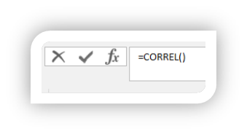
Cont’d - Correlation Co-efficient
Using the excel function =CORREL(), the correlation co-efficient determined was 0.995544.
This showed a very strong positive relation between number of schoolings years and the income level.
Supporting the thesis statement, the strong positive correlation shows that Canadians with more years of schooling tend to have higher incomes.
This support the notion on noticeable similarities in the relationship between income levels and level of education.
In addition, based on the line of the best fit on the scatterplot graph, as number of years increases, the income also increases.

Slide 13
Summary of Things Learned from the Project
Different key insights were learned from this project.
The analysis revealed a strong relationship between number of years and average income among the Canadians.
The project underscored how visual tools could be used to provide valuable visual representation, helping to show strengths, potential outliers, and patterns.
While, the project help reveal valuable insight, it was easier to highlight other aspects that could have contribute to the disparity on income and education among the Canadians.
In summary, the project contributed a lot to understanding the importance of data, and how it could be understand situations or scenarios.
For instance, through the data, one can highlight why there is differences between income levels among Canadians in different levels of education.
I think I should continue with Ph.D. to make higher income…

Slide 14
Works Cited
Government of Canada. (2023). Distribution of earners, by highest certificate, diploma or degree and earnings/employment income - Dataset - Open Government Portal. Canada.ca. https://open.canada.ca/data/en/dataset/4532ece3-0f45-4359-8a07-ae28cf74d477/resource/913e587e-d31d-43da-bec0-07bfb1feae0a
‌Ministry of Labour, Immigration, Training and Skills Development, (2023). Wages by education level - Ontario Data Catalogue.. Ontario.ca. https://data.ontario.ca/dataset/wages-by-education-level
Census of Population. (2017, November 29).‌ Does education pay? A comparison of earnings by level of education in Canada and its provinces and territories Census in Brief. https://www12.statcan.gc.ca/census-recensement/2016/as-sa/98-200-x/2016024/98-200-x2016024-eng.pdf

Slide 15
Thank you

