Slide 1
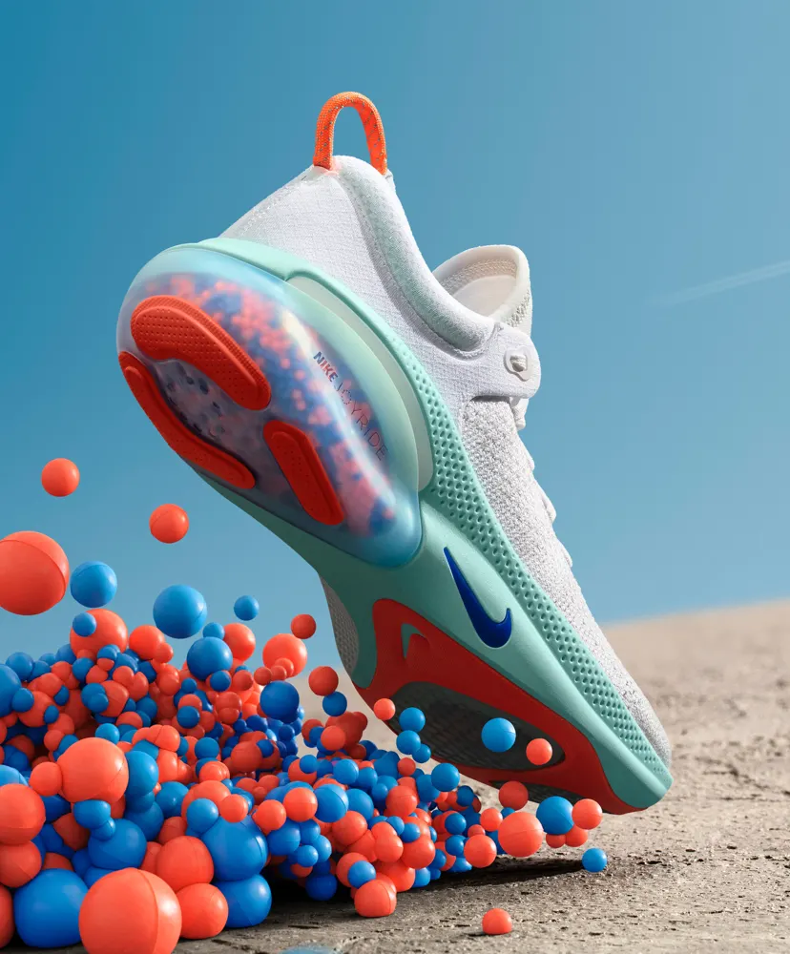
Adapting Brand Marketing Strategies to International Markets
Prepared by:
Course
Date

Slide 2

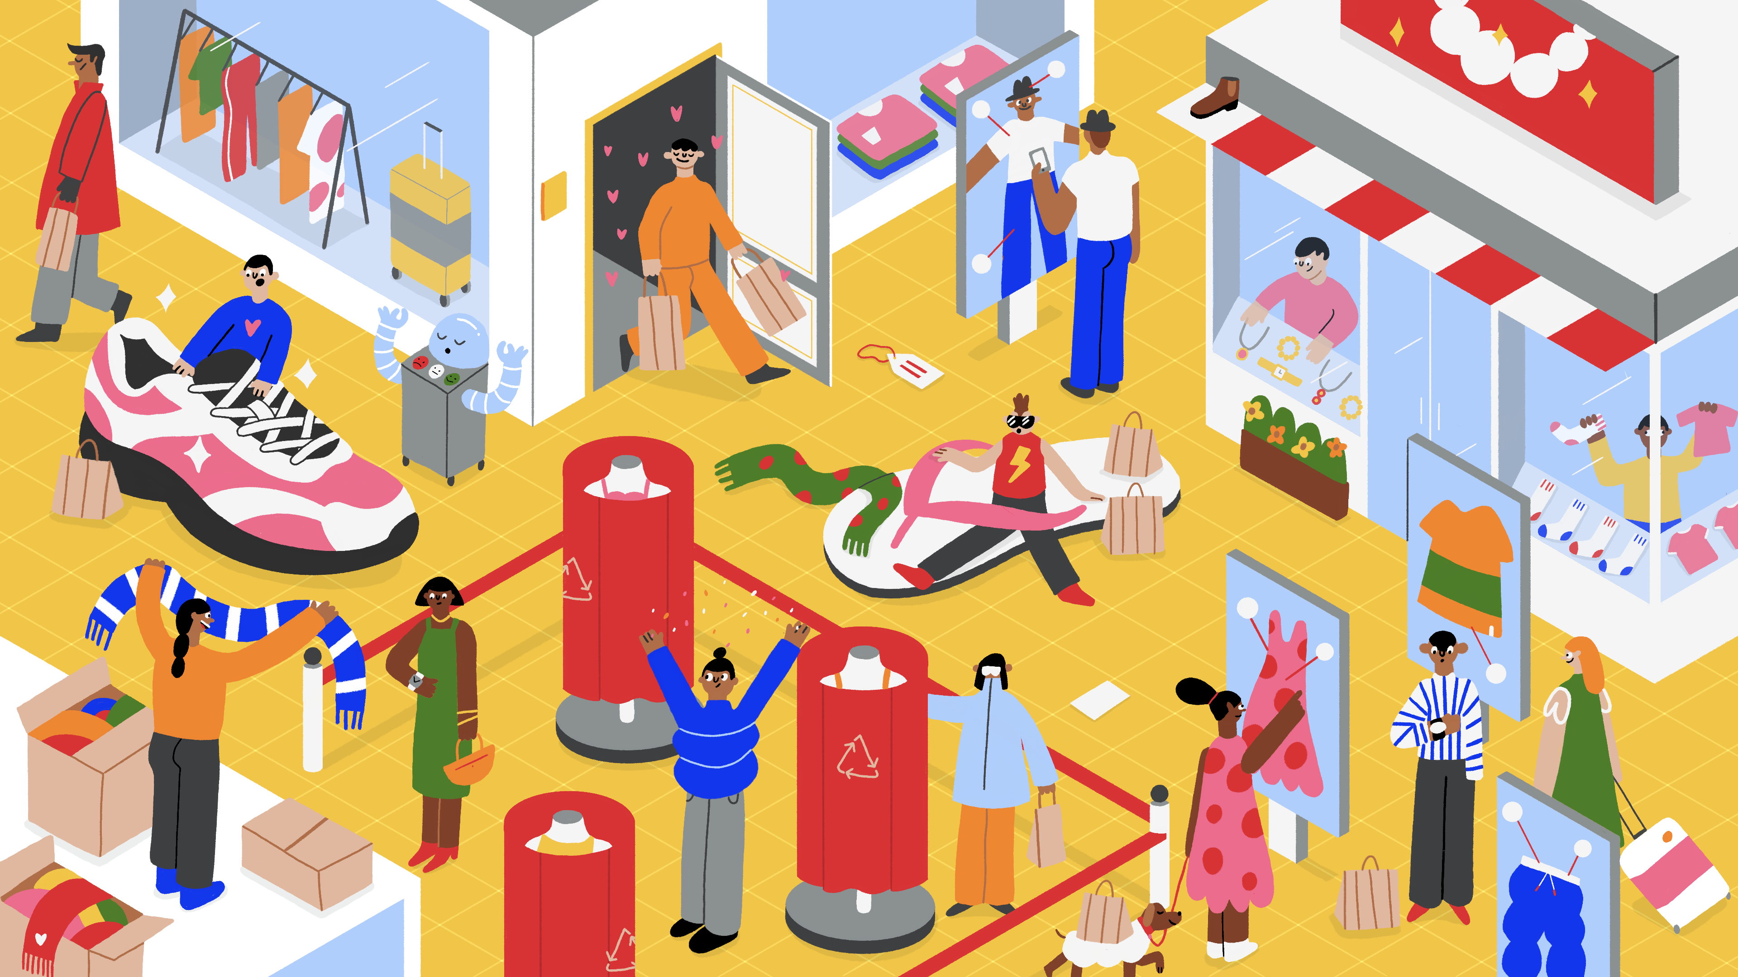
Introduction
In the modern dynamic global marketplace, fashion brands are experiencing challenges as they try to adapt their marketing strategies to international audiences (Sherman, 2018).
The objectives guiding this presentation include the following;
To understand how fashion brands such as Nike and others navigate in the international markets.
To explore the advantages and challenges of direct-to-consumer distribution.
To explore how the e-commerce platforms and changing consumer preferences affect the modern market.
The fashion brands used in this presentation include Levi, Guchi Nike, and Hodinkee, as they have successfully embraced DTC distribution.

Slide 3

Centralized Vs Decentralized
Centralized
Decentralized
The decentralized supply chain design allows each site to hold its procurement and deal directly with the local suppliers.
The model can provide additional flexibility for local market changes or preferences and be a very good pointer for local markets on how to respond to new menu items or seasonal offerings faster and in a responsive manner (Alamsyah et al. (2023).
The centralized supply chain design involves only one distribution center or warehouse that prorogues, stores, and distributes all necessary resources.
Centralized systems in the management of coffee supply chains enhance sustainability and the scalability of operations (Nguyen & Sarker, 2018).
Supplier deliveries of espresso beans, milk, flavorings, paper cups, lids, sleeves
Central warehouse receives, stores, and distributes to each location
Direct supplier deliveries to each location

Slide 4
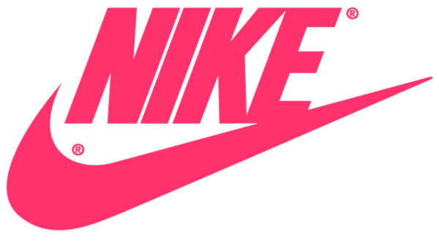

Cont’d;
ii. Nike
Community engagement: Nike fosters’ engagement with local communities through programs such as sponsorship and events, improving brand awareness.
Digitalization: Nike has utilized digital tools such as e-commerce platforms, offering personalized experiences as international consumers can explore products shared on the website (Salpini, 2021).
Consistency: Nike maintains a consistent brand identity across different international markets. For instance, its slogan, “Just Do It,” is reflected worldwide, but the company features local influencers and athletes.
iii. Hodinkee
Digitalization: Hodinkee prioritizes using digital tools, including an e-commerce platform, to reach a global audience (Chen, 2022).
Collaborations: Hodinkee collaborates with popular watchmakers and other luxury brands across different international markets, driving brand visibility and demand.
Niche marketing: Hodinkee targets a unique audience, including watch collectors and enthusiasts, in its international marketing.

Slide 5
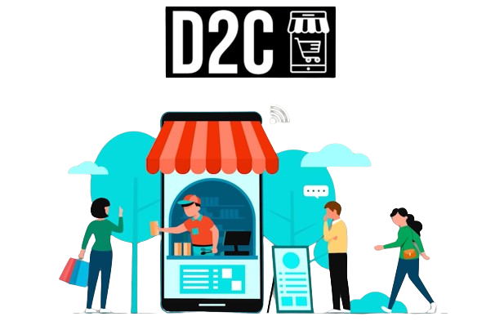
Direct-to-Consumer (DTC) Distribution
Direct-to-consumer distribution has emerged as an important approach for brands aiming to streamline their marketing strategies in international markets.
Advantages of DTC Distribution
Improved brand control: Directly selling to consumers helps improve brand image, customer experience, and product positioning. For instance, Nike’s DTC channel helps the company to control the quality and authenticity of its products.
Increased profits: DTC eliminates intermediaries, helping capture larger profits. Levi experienced increased sales by 40% through DTC (Anderson, 2021).
Personalization and data insight: Through DTC channels, brands get insights into purchasing patterns, preferences, and consumer behaviors. Guchi adopts DTC offering personalized marketing messages to targeted customers in china (Chitrakorn, 2021).
Challenges to DTC
Managing DTC requires significant investment in logistics, technology, and infrastructure capabilities.
The DTC brands experience intense competition, making it challenging to stand out.
Retaining and getting new customers in the DTC marketplace is challenging, where brands must invest heavily in marketing approaches.

Slide 6

Influence of E-commerce Platforms and Consumer Preferences
The rise of e-commerce platforms such as websites and applications, as well as the shift in consumer preferences, has significantly impacted the trajectory of DTC.
This has reshaped how international brands conduct their businesses or engage with customers.
E-commerce Platform
Improved shopping experience: The e-commerce platforms facilitate a convenient shopping experience, as customers compare, browse, or buy products from the comfort of their homes (Sherman, 2018). For instance, Nike and Levi have website platforms where users can purchase or browse products.
Increased reach: Through these e-commerce platforms, brands are able to tap into new demographics and markets.
Changing Consumer Preferences
Embrace social commerce and digital preferences: Consumers embracing media platforms and digital channels has transformed how brands interact with them. For instance, Levi, Nike, and Hodinkee have adopted the power of social commerce, changing their advertising campaigns.
Shift towards transparency and sustainability: Customers are prioritizing brands that show commitment to transparency, ethical practices, and sustainability.
Preference for personalization and convenience: Modern consumers want personalized experience and values convenience on their shopping, driving brands to adapt to DTC strategies (Sherman, 2018).

Slide 7

Conclusion
There are key takeaways from the presentation.
Strategic adaptation: Brands such as Levi, Nike, and Hodinkee have shown innovation and agility by adopting unique marketing strategies in their international markets. The unique adaptation strategy among the different brands is using e-commerce platforms, increasing engagement.
Opportunities and challenges: DTC distribution offer various opportunities such as data-driven personalization, increased profits, and better brand control. On the other hand, some of the challenges include increased competition or saturation, customer acquisition, and infrastructure investment.
Evolving landscape: DTC continues to evolve, driven by shifting consumer preferences and the rise of digital tools such as e-commerce platforms towards convenience, sustainability, and personalization.
Future outlook: As DTC continues to change, brands must adopt better strategies such as carefully observing the market trends, technological change, and consumer preferences, helping stay ahead of the curve.

Slide 8
References
Chen, C. (2022). Building a DTC Challenger Brand. The Business of Fashion, May, 25.
Sherman, L. (2018, July 16). How to Set the Right Price. The Business of Fashion; The Business of Fashion.
Chitrakorn, K. (2021, January 25). Gucci, Loewe tap nostalgia marketing ahead of Chinese New Year. Vogue Business; Vogue Business.
Salpini, C. (2021, March 23). How Nike is using DTC and data to expand its empire. Retail Dive.
Anderson, G. (2021, April 12). Levi’s (Like Nike) Strives To Be A Direct-To-Consumer Powerhouse.

Slide 9
Thank You

